Slide 1
COMP 1073
Client-Side Scripting
Lesson 3 – Part 1
Storing Data in JavaScript

Slide 2
Objectives
In this Lesson we will learn about:
Variables
Arrays
Objects
JSON
Web Storage in HTML5

Slide 3
Storing Data in JavaScript

Slide 4
Introduction – Storing Data in JavaScript
Storing data is core functionality of JavaScript.
In this lesson, you learn the different methods of storing data within a JavaScript model.
Some methods are internal to your own personal scripting file and some are consumed externally.
Externally generated data can be produced by a database local to your application or an external API service (we’ll get into APIs).
In some form or another, you will be storing and caching data on every project.
Knowing not only your options but the proper times to use them can be very valuable when you’re trying to create a codebase that performs well and is reasonably easy to maintain (a constant balancing act for all front-end code).

Slide 5
Variables

Slide 6
Variables
Variables are the most basic forms of data storage in JavaScript.
They’re used in all programming languages but are especially important here because they are an unavoidable aspect of writing good, high performance JavaScript.
A variable is a label that you attached to a value.
Sometimes the value changes, sometimes it doesn’t. But the label will always stay the same so you can reference it throughout your code.

Slide 7
Variables (Cont’d)
Variables can be used a few different ways. You can self-define static variables, you can self define dynamic variables, or you can use variables that take into account user interaction.
These can be in the form of strings, numbers, or Boolean values.
These values can then be passed into a function, checked, combined, or modified as you need throughout your program.
The first step in creating a variable is called declaring a variable, which sets the label to what you want.
Something to remember when declaring variables is that they are case sensitive, so uppercase versus lowercase always matters.

Slide 8
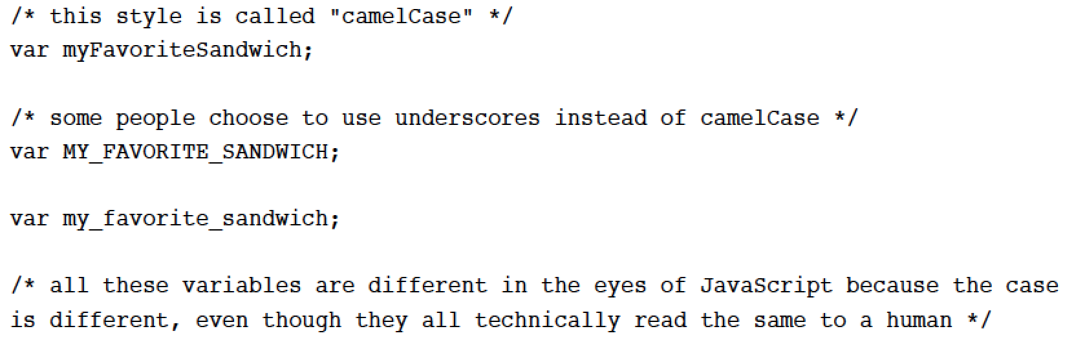
Variables (Cont’d)
In the following Listing, you can see a few basic variable declarations.

Slide 9
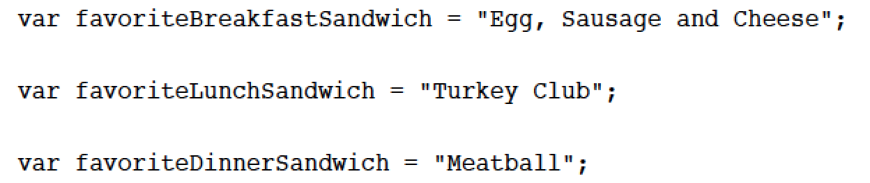
Strings
A string is the first type of data that can be assigned to a variable.
It’s nothing more than a collection of characters and can be anything from a single word to an entire paragraph or even multiple paragraphs.
They’re contained within quotes and are set with an equal sign (=).
In the following Listing you can see the variables we’ll be using starting to be formed via strings.

Slide 10
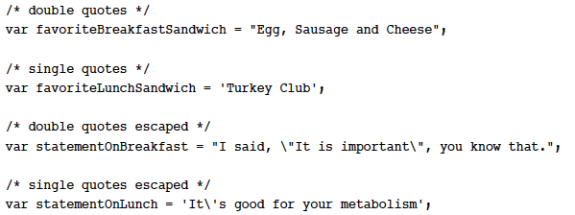
Strings (Cont’d)
Strings can be saved to variables with either single or double quotes; they both produce the same result, and it’s more a matter of personal preference.
Because both single and double quotes are commonly used inside saved strings, they will often break your JavaScript and need to be escaped.
In the following Listing you can see variables saved with single quotes, double quotes, and examples of escaping them where applicable.

Slide 11
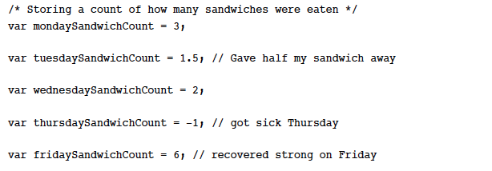
Numbers
Numbers are exactly what they sound like: they are number values saved to variables.
Numbers can have math preformed on them with JavaScript operators.
All the basic math functions are available: addition, subtraction, multiplication, and division.
Numbers can be positive, negative, or even decimals.

Slide 12
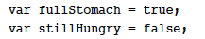
Boolean
Unlike strings and numbers, which can have endless possibilities for their values, Boolean values can be only true or false .
Like numbers, Boolean values are not contained within quotes.
They are often used in basic yes / no situations, such as when checking for support of a certain feature in a browser.
In the following Listing you can see an example of a Boolean true value and a Boolean false value.
Instead of using true and false, you can use the number values 0 or 1: -- 0 meaning false, and 1 meaning true; these are both also considered to be Boolean values.
This can be tricky if you’re setting a 0 as a number value because a Boolean comparison will treat the value as false .

Slide 13
Performance in Variables
When declaring a variable, you’re caching it in your JavaScript file and allowing it to be used over and over.
This can be a great way to increase the performance and maintainability of your script.
Because there is a very slight amount of overhead in fetching the variable, a general rule of performance is to store data in a variable if you need to use it more than once.

Slide 14
Arrays

Slide 15
Arrays
Most variables can hold only a single string, a single number, or a single Boolean value.
A lot of times you need more than that. If you need to store actual data in a variable, you would use what is called an array.
They’re declared in a similar way, with a var declaration, but they can contain much more information to be passed throughout your JavaScript.
An array is basically just a list of stuff saved into one variable.
The benefit is that you can directly access each item in the array while having them grouped together in a logical way.

Slide 16
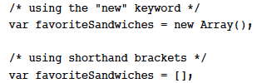
Arrays (Cont’d)
In the following Listing you can see the two ways you can declare an array.
After declaring the array, you need to fill it with stuff.
If you have the values figured out already, you could combine the processes of declaring the array with assigning it values.
As you’ll find out later, you can dynamically add items to an array, but for now, let’s manually put them in.

Slide 17
Arrays (Cont’d)
The following Listing shows a combination of declaring the array and assigning it some values.
Like a normal variable, the values in an array can be any combination of strings, numbers, objects, other arrays, expressions, and/or Boolean values.

Slide 18
Basic Array
As mentioned earlier, an array is a list of stuff (usually related stuff) and the previous Listing depicts an array in its most basic form.
When you combine the declaration of an array with the value assignment, as we did in the previous Listing, a number gets assigned to each value. This number is called an index .

Slide 19
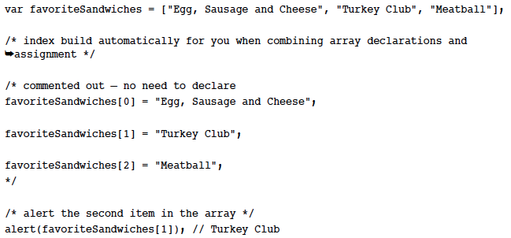
Basic Array (Cont’d)
In the following Listing you can see the index assignment that gets generated for the array declared in the previous Listing.

Slide 20
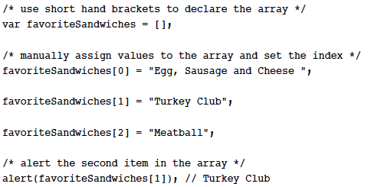
Basic Array (Cont’d)
Notice that the index value starts at 0 rather than 1.
The index values can also be assigned manually if you choose to do so, shown in the following Listing.

Slide 21
Multidimensional Array
Multidimensional arrays are arrays of arrays. As mentioned earlier in this lesson, you can save any kind of data to an array, even other arrays.
To this point the favoriteSandwiches array has been pretty limiting.
What happens if we have more than one favourite kind of sandwich for each meal, and we want to combine them into a single data source?
This is where multidimensional comes into the mix.
You would first have to split the three meals into separate arrays: breakfast, lunch, dinner; then take those three arrays and add them to a fourth array.

Slide 22
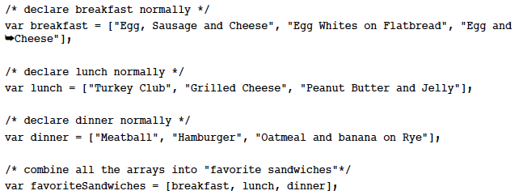
Multidimensional Array (Cont’d)
Let’s take a look at this in the following Listing:

Slide 23
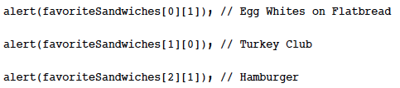
Multidimensional Array (Cont’d)
This is a way to get more data crammed into favoriteSandwiches while keeping the structure meaningful and reusable throughout the rest of your code.
Accessing a multidimensional array can be tricky, so let’s go over it piece by piece.
The following Listing shows how to pull out various sandwich types from the array:

Slide 24
Multidimensional Array (Cont’d)
Let’s get into what’s really going on in this data call: favoriteSandwiches[0][1], which returns “Egg Whites on Flatbread.” This is a step-by-step process for what is going on.
Access the array called “ favoriteSandwiches .”
Go into the 1 st item (breakfast); remember, arrays start at 0, not 1.
Inside of “breakfast” get the second item (Egg Whites on Flatbread).
Alert the result.
That same pattern is applied for each time the array data is accessed.
You have to pass through the first array before moving onto the second.

Slide 25
Pushing Data into an Array
Now that you know all the different types of arrays and how to pull data from them, the next logical step is to start dynamically adding content into an array (you don’t always have to do it by hand—that would be awful).
There will often be times when you need to add new information to an array, either generating the information yourself or gathering it through user input— they’re both equally common.

Slide 26
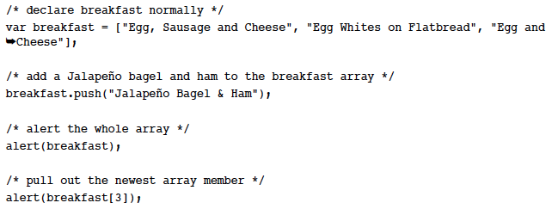
Pushing Data into an Array (Cont’d)
The following Listing expands on the breakfast array.
In this example we want to do a few things:
Add Jalapeno Bagel & Ham to the breakfast array.
Alert the entire array to confirm that it was added properly at the end.
Directly access the newly added array item (Jalapeno Bagel & Ham) and alert it.

Slide 27
Working with Array Methods
Accessing and removing items from an array are all the basic interactions you will encounter, but because this type of data storage is so critical, JavaScript opens up a whole slew of methods dedicated to the purpose of interacting with arrays.
The methods we’ll be going over are
join
slice
shift and unshift
pop
concat
sort

Slide 28
join
The join method is a way to combine all the items in an array quickly with a certain term or separator.
The join method will convert all items in an array to a string and output them in a format you specify.
In the following Listing you can see that we’re working with the same meal-based sandwich arrays we have been using throughout the lesson.
Join takes one parameter, which is the string value you want to output in between each array item. In this case it is “, plus ”.
The result will be [array item], plus [array item], plus [array item].

Slide 29
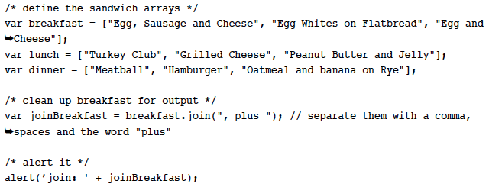
Join (Cont’d)

Slide 30
slice
slice has the capability to output a range of items in an array.
For example, if you want to output items 1 through 4 and leave out item 0 and anything higher than 5, that is a range of values you can target with slice.
In the following Listing we’re accessing the lunch array and outputting values 1 & 2 (Grilled Cheese, Peanut Butter and Jelly) and joining them with an ampersand (&).
The slice method takes two parameters, the first is your starting position and the second is your ending position in the array.
The start parameter is required, the end is optional.
If it’s omitted, the slice will just continue to the end of the array.

Slide 31
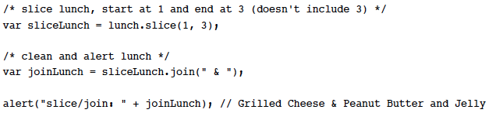
Slice (Cont’d)

Slide 32
shift and unshift
shift and unshift are methods used to add and remove items to / from the beginning of a specified array.
In the following Listing the shift method is set to remove the array item “meatball” from the dinner array defined in the following Listing.
The unshift method will then add the array item of “Nacho Cheesewich” to the beginning of the same array.
You can then see the resulting array with “meatball” removed and “Nacho Cheesewich” added for an extra-delicious dinner sandwich array.

Slide 33
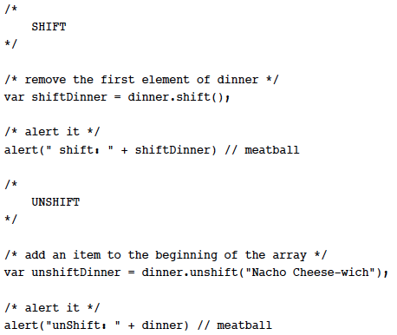
shift and unshift (Cont’d)

Slide 34
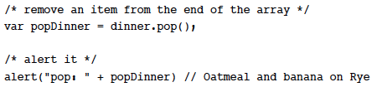
pop
pop is a method reserved for removing and returning the last item in an array.
In the following Listing you can see an example of how to remove the last item from the dinner array to return an Oatmeal and Banana Sandwich on Rye bread.

Slide 35
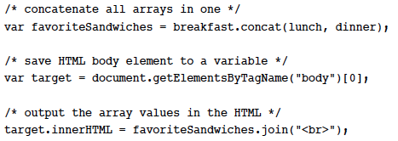
concat
concat is short for “concatenate.” It’s a method of copying and combining multiple arrays into a single array.
The original array still exists because the combined array is only a copy.
In the following Listing you can see that the breakfast, lunch, and dinner arrays are all being concatenated into the new “ favoriteSandwiches ” array.

Slide 36
sort
sort is an interesting method; it can output alphabetical or custom sorting of array items.
It takes one optional argument, which is a custom sorting function you would have to write.
Otherwise, it will use basic alphabetical sorting.
Something to note is that that numbers will not be sorted correctly; 30 will be considered lower than 4 because sort does not take into account true numerical sorting.

Slide 37
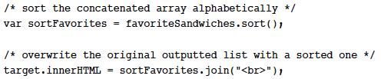
Sort (Cont’d)
In the following Listing we are using the sort method on the favoriteSandwiches array and outputting the alphabetical listing of all combined array items.

Slide 38
Objects

Slide 39
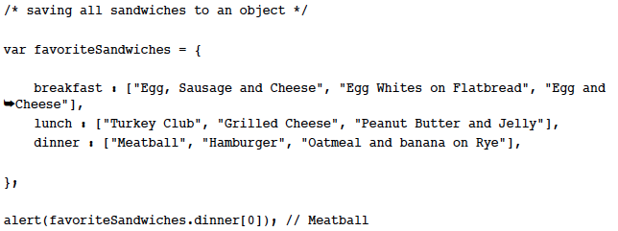
Objects
When data starts to get overly complex and difficult to consume, I often find myself turning from arrays to objects.
You can still save arrays to objects, but rather than piling them into complex, multidimensional arrays, you can create a more human-readable format (in my opinion) with objects.
In the following Listing you can see how you might save all the favorite sandwich data into an object, and then access an individual item in each array.

Slide 40
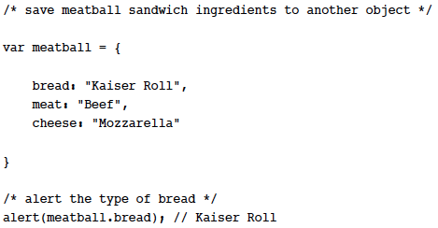
Objects (Cont’d)
Objects, of course, don’t have to contain arrays like that; they can also contain strings, numbers, Boolean values, or even entire functions.
They are very flexible and are often the coding method of choice on larger projects where consistency is a high-level concern.
The following Listing shows a basic array of meatball sandwich ingredients and how to access an individual item.

Slide 41
Performance in Objects
The objects you’ve seen so far have been only a single level deep, but the possibilities are limitless in how deep you can nest an object.
They are great for organization and making your code more modular, but this is part of the constant balancing act you will encounter when weighing the benefits of performance versus maintainability.
For example, in the previous Listing, accessing the meatball object has the following process:
Access “meatball”
Access “bread”
Alert the value “Kaiser Roll”
That three-step process takes more processing time than if you were to use the string “Kaiser Roll” directly, but if you needed to use it over and over, your code would start to become a tangled mess.
Only traveling one level deep to retrieve a string isn’t much of a problem, but when you start getting 3, 4, or 5 levels deep in your nesting, you may hit some performance problems.

Slide 42
JSON

Slide 43
JSON
JSON is one of the newer data storage methods in JavaScript; it has been heavily used only in the past few years.
It stands for JavaScript Object Notation and is a very lightweight format for exchanging data both on the server and on the client.
It is not only easy to read and write for humans, but it is also easy to read and write for machines, so you get the best of both worlds.
All modern programming languages support JSON in some way, which makes it great when you have to integrate with other systems that may not be running on the same platform as you.

Slide 44
JSON (Cont’d)

Slide 45
Benefits of Using JSON
There are a lot of data formats in JavaScript; why would you choose JSON over something else?
Right off the bat you can tell that JSON is pretty human-readable, which is a huge benefit when you have to comb around someone else’s code and try to see what’s going on.
JSON is used with a lot of external services to transfer data because it can be consumed cross-domain.

Slide 46
Benefits of Using JSON (Cont’d)
Before JSON was popular, XML was the data format of choice if you needed to consume data from an outside source (like RSS), but you weren’t able to directly access XML cross-domain with JavaScript without passing it through a local proxy.
That’s where JSON comes in. It’s fast, lightweight, and can easily travel from one domain to another. It’s great for Ajax, and it’s great for general data storage.
JSON also matches data models from other programming languages, whereas XML does not.
Because JSON has cross-domain capabilities (and it’s really just JavaScript) it is important to use JSON only from a trusted source to guard against any sort of malicious behaviour.

Slide 47
Using an API
API stands for Application Programming Interface.
Many professional services will offer an API to developers to build and expand on their codebase.
Flickr has an API for you to pull images and content onto your own site, and Netflix has the same for movies.
Many other sites also function in a similar away.
For right now, it isn’t too important to understand exactly how an API works, but know that it is a way for a site (like Flickr or Netflix) to safely give you access to information they store in their databases for your own personal use.

Slide 48
Using an API (Cont’d)
When you make a request to the Netflix API, you would say (in JavaScript) something like, “give me a list of movies with ’dog’ in the title,” and the Netflix API would respond with a list of movies with “dog” in the title, the same as if you were doing a normal search from their website.
Instead of the search results coming back in a pretty, well-designed search result interface, the API results in a JSON format for you to parse through.
Most modern-day APIs work this way. You make a call and you get back data in JSON format.
The JSON format makes it consumable by any code base.
So if you’re using JavaScript, Python, PHP, Ruby, and so on, the data format never has to change (which is really nice).
APIs are probably the most common use of JSON today, and we live on the Web in an API-based economy, so being familiar with the data format both internally and externally to JavaScript is very important.

Slide 49
Web Storage in HTML5

Slide 50
Web Storage in HTML5
Up to this point in the lesson, we have been talking about data storage from the developer’s side (your side).
User interactions are what we do with JavaScript—it creates a behaviour layer (you know this).
With that in mind, the next step in your JavaScript data storage progression is to start using storage as a way to interact with the user.
In the past we’ve used cookies to save user-generated data, but let me be the first (one of the millions actually) to say that cookies are hacky, a pain to deal with, and insecure.
We’ve known it for years, and yet we continue to use them. The main problem with cookies is that they got such a bad rap for being riddled with tracking information and malware that people often browse with them turned off.
Luckily, there’s a better way and it’s built right into the language.

Slide 51
localStorage and sessionStorage
As mentioned, storing information locally in a user’s browser dates back to the early days of the Web and cookies.
Sometimes it’s just a mark saying, “I’ve been here before.” Sometimes it is actual data (name, address, and so on) triggered by some event.
Either way, it’s a powerful tool for creating a better and more personalized user experience in the browser.
In HTML5 you have access to two new storage objects: localStorage and sessionStorage.
These objects are paired with three methods: setItem , getItem , and removeItem.

Slide 52
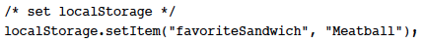
setItem
The setItem method takes two arguments. The first is the equivalent of a variable label, or what you want to call the data being stored.
The second argument is the data itself, which must be a string.
Calling setItem with local/sessionStorage will store the data locally with the user.

Slide 53
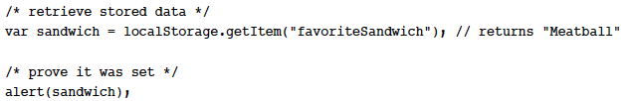
getItem
After setting an item, it’s only natural that you would want, at some point, to retrieve that same item.
Otherwise, why would you have set it in the first place? For this you use the getItem method.
It takes a single argument, which is the name of the item you previously set.
The following Listing shows how to retrieve the favoriteSandwich data that was set in the previous Listing by using getItem.

Slide 54
removeItem
A Web storage method to help you clean up after yourself; it is called “removeItem”.
This method will delete the item stored locally with the user.
It takes one argument, just like its companion method, getItem.
The following Listing depicts how to remove a locally stored item.
Both localStorage and sessionStorage use the same syntax and methods.
The only difference between the two objects is that localStorage will remain active until explicitly removed by you (the developer) or the user, via the browser preferences; it’s actually pretty difficult for a user to clear.
sessionStorage acts differently because it is a session-based storage method, which means it will remove itself at the end of each browser session (when the browser is closed).

Slide 55
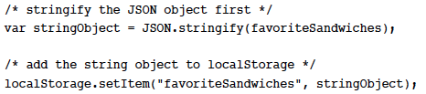
Storing Chunks of Data with JSON
Web storage currently can take only strings for data.
This can be problematic when you need to store multiple items.
You can get around this limitation by storing your data in a JSON object and then using the JSON.stringify method to convert the entire object to a string that can be stored using Web storage.
The following Listing shows how you might take the entire favoriteSandwiches JSON object that was created and save it locally with Web storage.

Slide 56
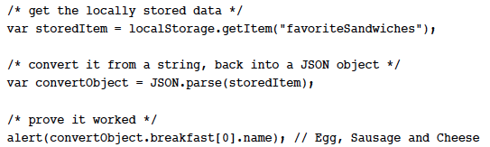
Storing Chunks of Data with JSON (Cont’d)
Because this JSON object is now a string, and the individual items in the object can’t be accessed efficiently, when you access this item it needs to be reconverted from a string, back into a JSON object.
The following Listing shows you how to use JSON.parse to convert the string back into a workable JSON format.

